Slide 1
Wine reviews - prose of life
Krzysztof Juszczyk, Mateusz Serzysko, Maksymilian Czudziak

Slide 2
Task: predict wine review score.
Wine features:
region/province
winery
variety
review points
price
description

Slide 3
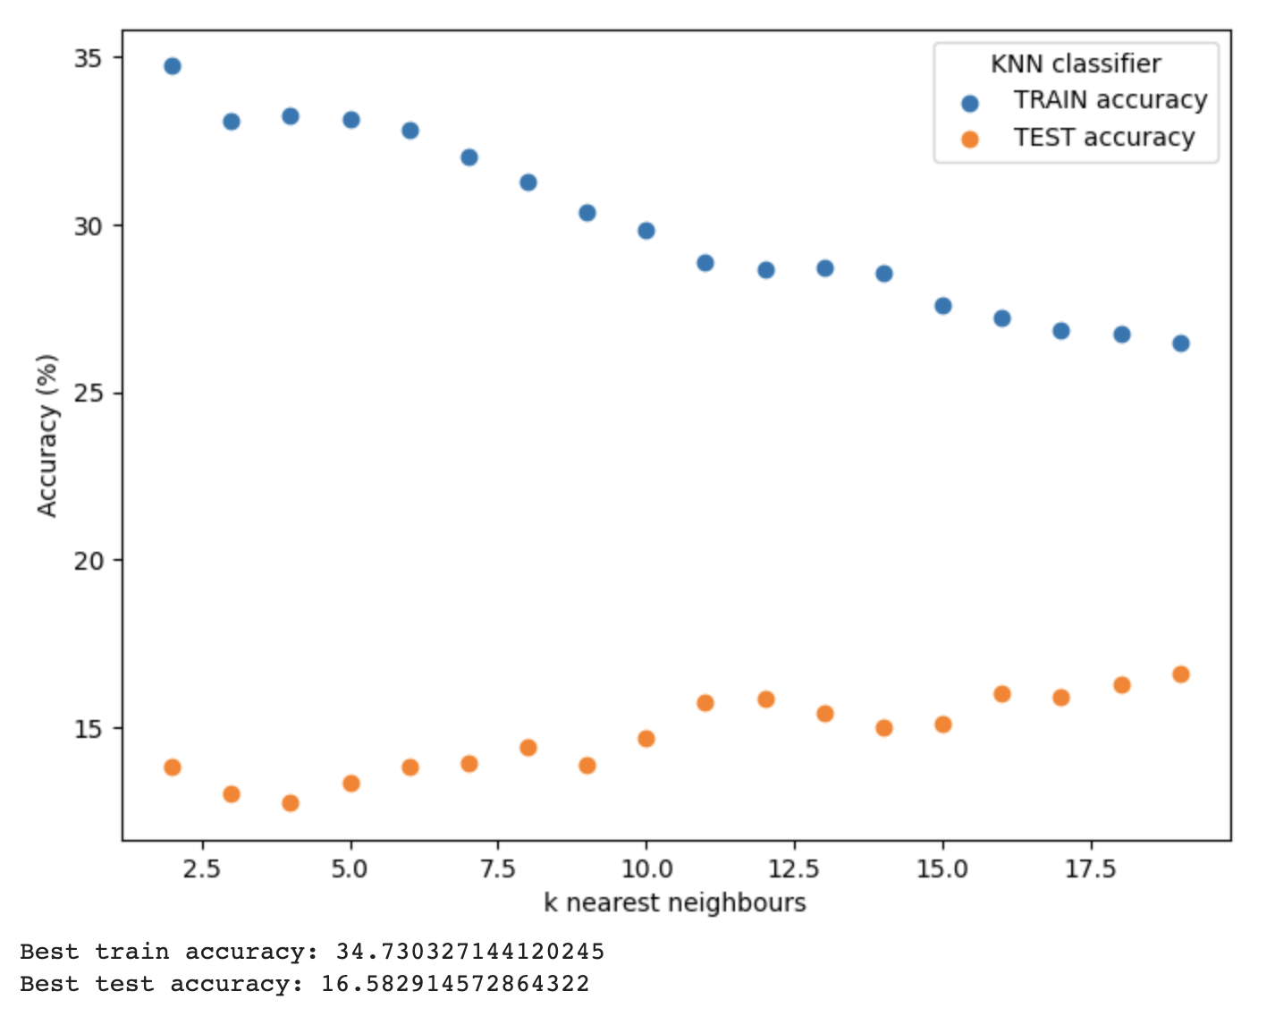
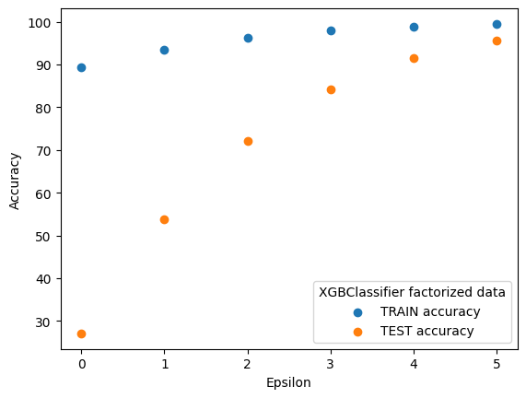
Predicting on raw data
We factorized: country, province, region, winery, variety

Slide 4
Data analysis
and (or?)
Data massage

Slide 5
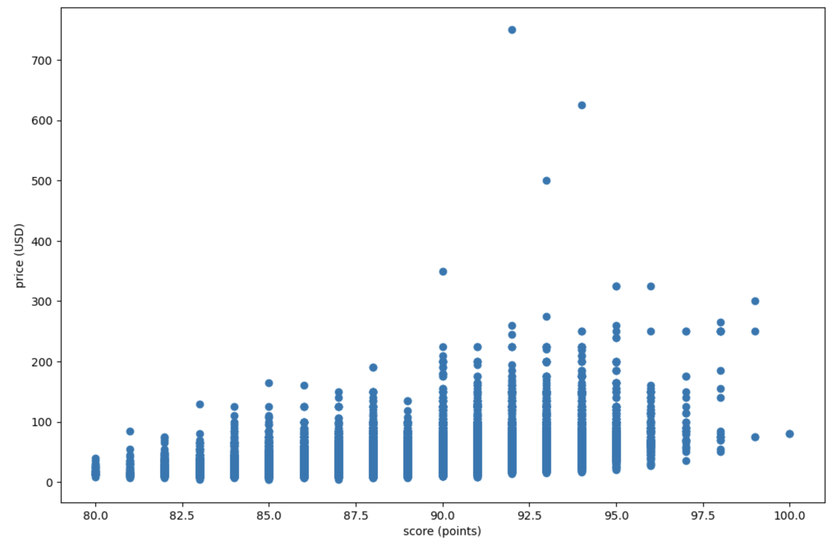

Slide 6
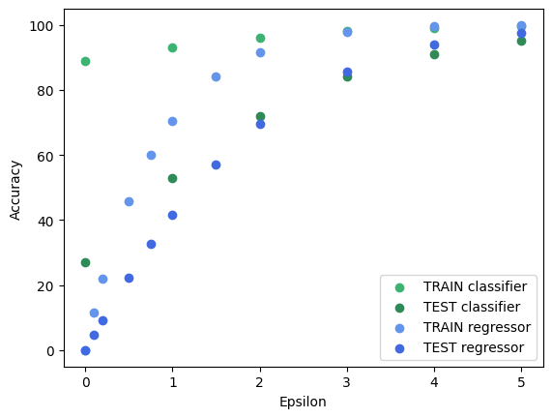
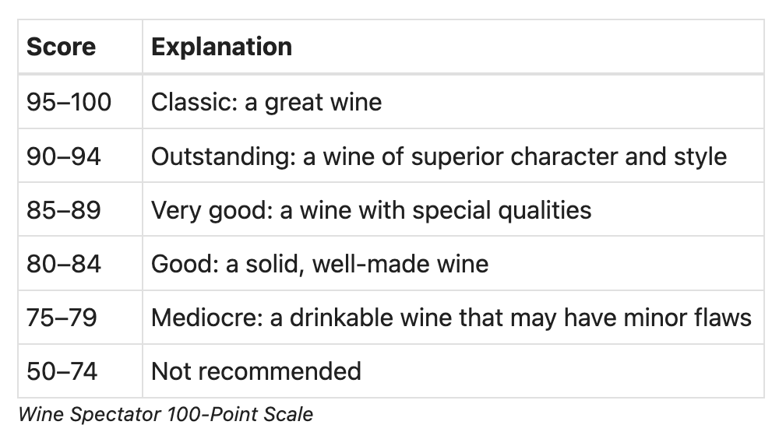
XGBClassification vs XGBRegression
IRL:
So balanced epsilon equals 2

Slide 7
How to handle categorical data?
Factorization
“Northern Spain” → 7
Naive solution, we can do better
One-hot encoding
“region” → “is_nothern_spain”
When one-hot encoding
we got 57 kB for one row, it is too much
Categorization in XGBooost lib
Geography
Text analysis
Features in categorical format:
region/province
winery
variety
description

Slide 8
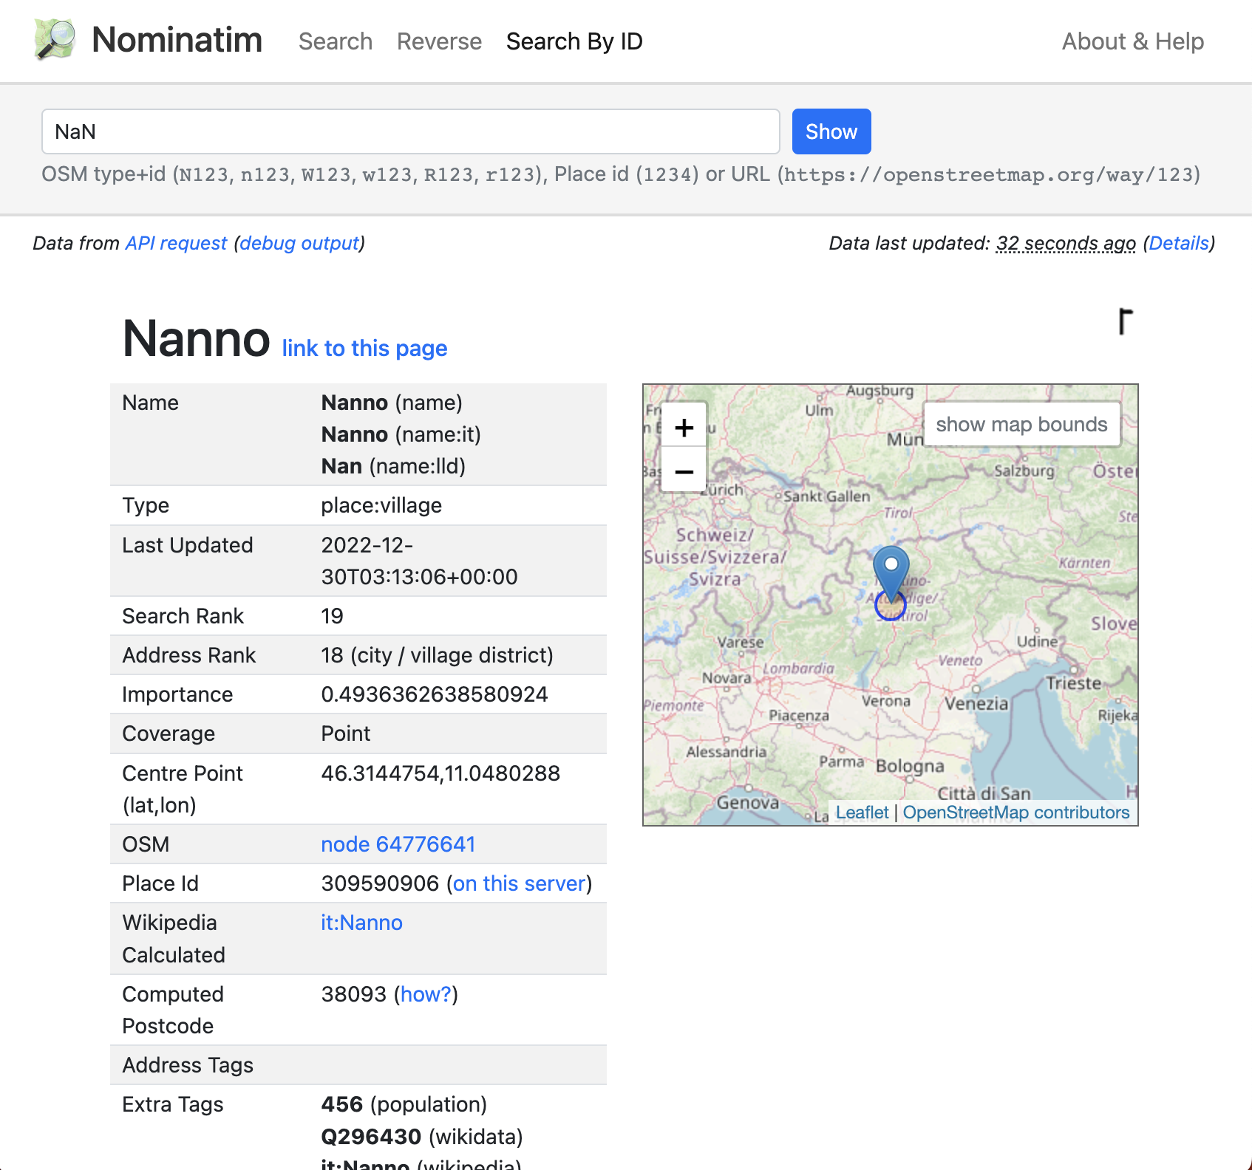
Geographical data translation
Translate region / province / country name to geographical coordinates and later to XYZ spherical coordinates.

Slide 9
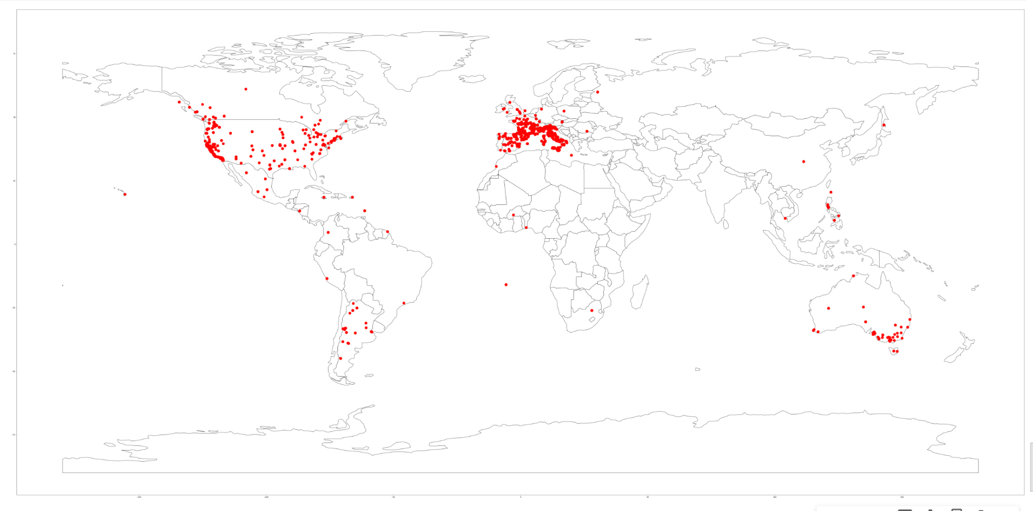

Slide 10
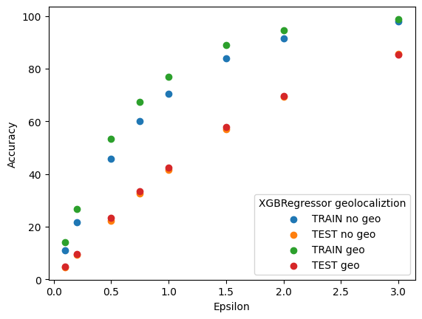
XGBRegression without vs with coordinates
We decrease the amount of categorical data, without accuracy loss.

Slide 11
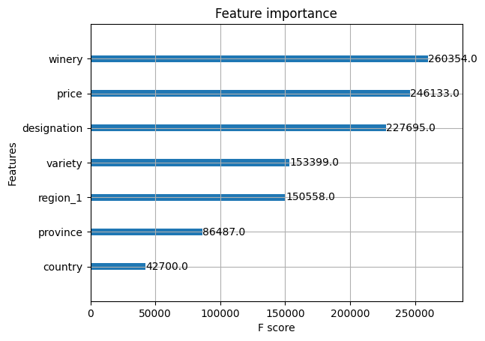
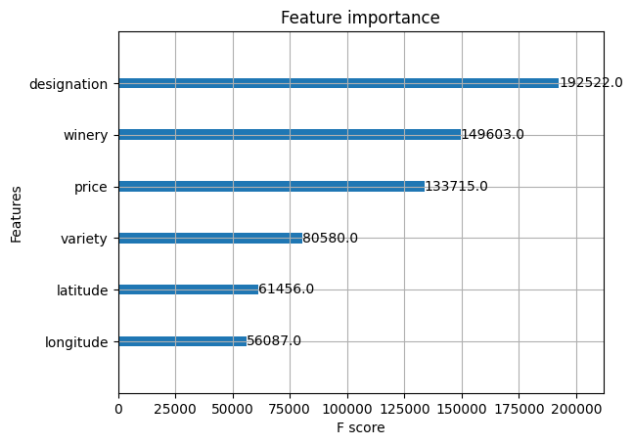
Does geography matter?

Slide 12
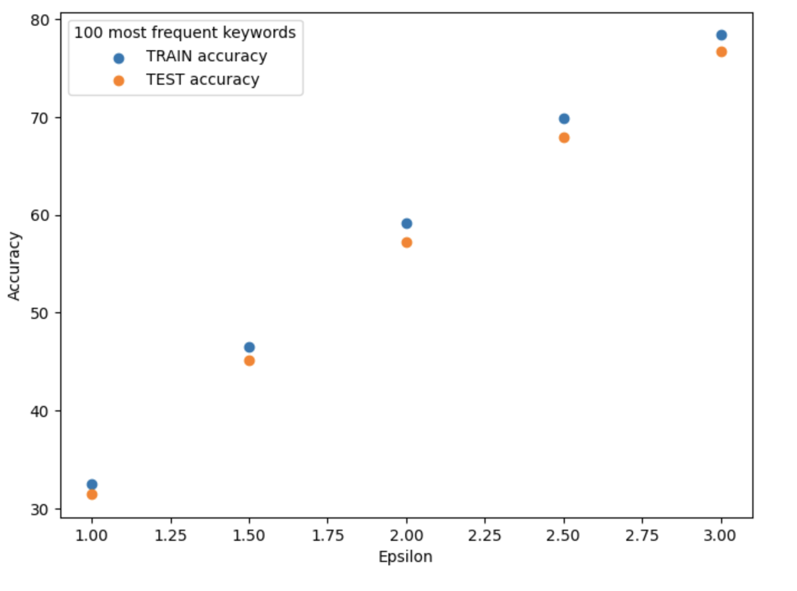
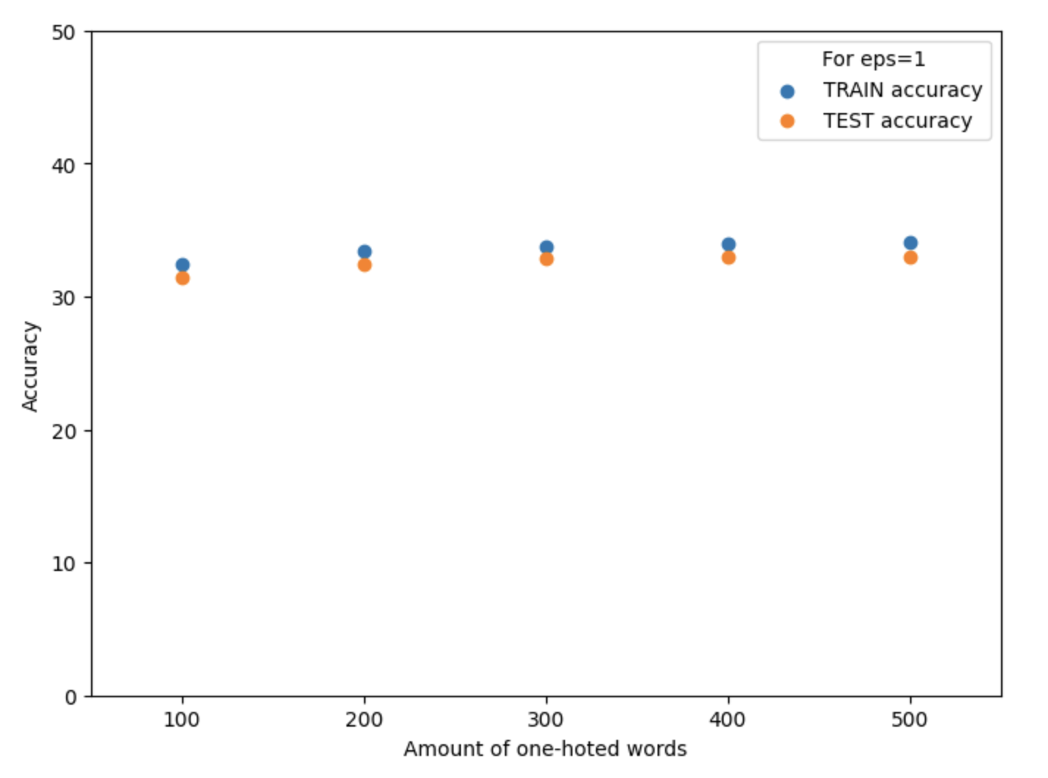
Basic text analysis
For each description, find all adjectives
Narrow their amount to 200 occurring most frequently
one-hot encode them

Slide 13
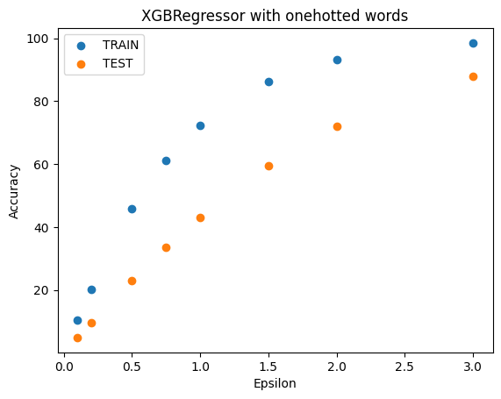
Combining everything together
XGBRegressor
categorical features and 200 most frequent words one-hot encoded
geographical places translated to spheric coordinates

Slide 14
Know your data

Slide 15
Links to collabs:

